Slide 1
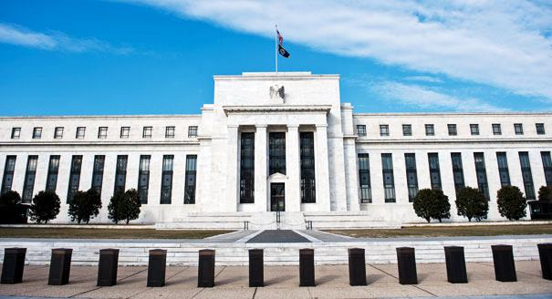
Lecture 23: The Federal Reserve
Outline
The structure of the Fed
The dual mandate
Picking the right interest rate
Tools of the Fed
Required Reading
Stevenson Wolfers Ch 22: all

Slide 2
The structure of the Fed
This is our second lecture on applied monetary policy.
We focus today on the “who” and “how” of monetary policy
The Federal Reserve and its tools
The Fed is deeply entwined in the banking system and the regulation of money in the US
Because the US is a global center of finance, that means it’s deeply entwined in the status of the global economy
It’s one of the most powerful institutions in the world, and is greatly misunderstood (or ignored!)

Slide 3
The structure of the Fed
The Federal Reserve was created in 1913 by the Federal Reserve Act, was given real teeth to regulate commercial banks in 1933 by the Glass-Steagal Act
Federal Reserve, as central bank, is “the bank of banks”
In charge of oversight and regulation of the banking system
Federal Open Market Committee (FOMC) is the arm of the Fed that engages in monetary policy
The Fed is semi-autonomous
There are 12 district banks “owned by local banks,” which serve to audit and supervise these local banks
The Chairperson (currently Jerome Powell) must answer to Congress on a regular basis
Notes:
https://www.minneapolisfed.org/about-us/our-history/history-of-central-banking
Commercial Banks are distinct from Investment Banks, which engage in riskier practices with the money of large investors (think Goldman Sachs), though the legal distinction largely broke down in the late 1990s.
The idea of having non-elected appointees is that they are answerable to the democratic “will of the people” via the appointment process, but once appointed, they are more like bureaucrats. That is. Not subject to the changing winds of popular opinion, political expediency, etc. They are legally obligated to do what’s best for the nation in the long term, not for their particular constituency, and not just until the next election cycle.

Slide 4
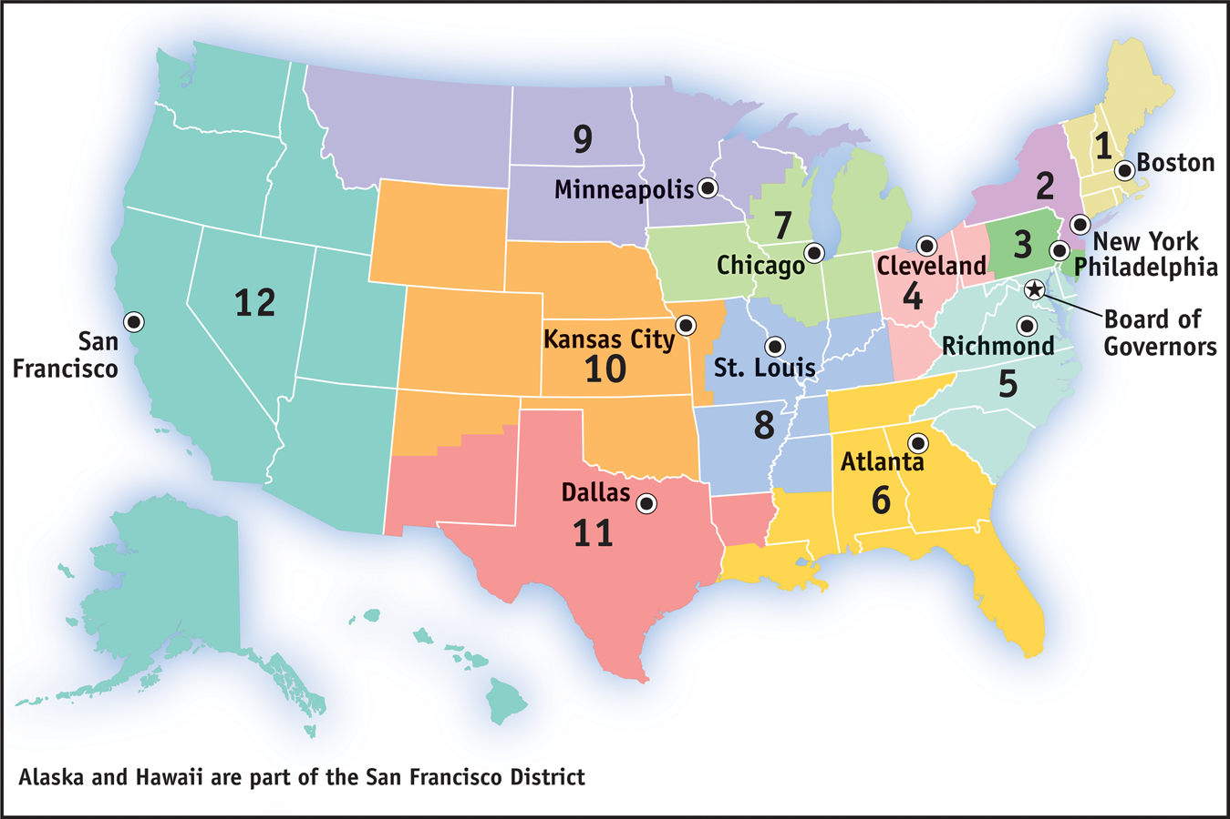
The structure of the Fed
Notes:
Here we can see the 12 district banks, each with a separate geographical district.
Two notable locations:
1) The board of governors in DC, which has no “district”, but oversees the entire system. These governors are always on the FOMC, as is the Chairman, who also is based in DC.
2) The NY Fed, which (being in the center of the biggest financial market in the world) executes the main Fed tool of monetary policy, open market operations. The NY branch manager is always on the FOMC.
- All the other branches have managers who rotate on and off the FOMC.

Slide 5
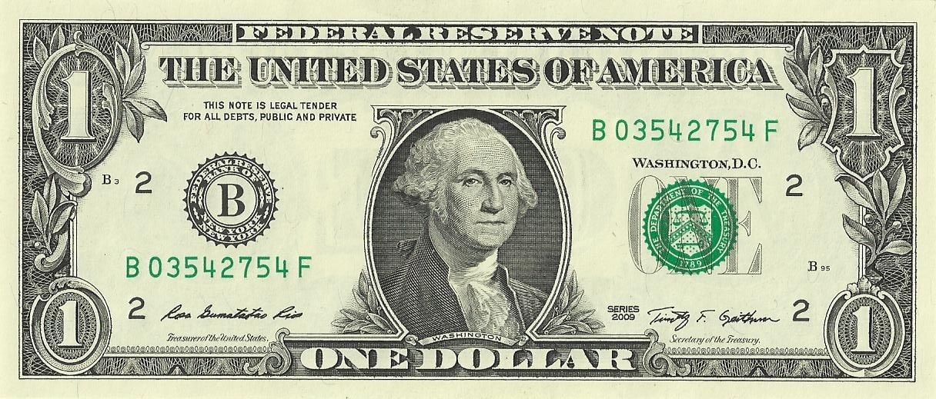
The structure of the Fed
Notes:
The Department of Treasury literally physically prints money – that’s why the two signatures on the bill are from Treasury. But the literal first words on the bill are “Federal Reserve Note”. When a bank needs cash, it is the Federal Reserve Bank that permits currency to circulate, and has the capacity to provide that cash to banks.
“Legal tender” means that if you owe a debt in the US, one possible method of payment must always be the US dollar. It doesn’t mean that a business has to accept your dollar in exchange for their G&S. They can barter, etc, if that’s what they want.

Slide 6
The structure of the Fed
“Modern” central banking started around 1951, when the Fed gained a large degree of independence from the executive branch (which had leaned heavily on the Fed to buy government bonds in WW2)
The “The Great Moderation” of low and predictable inflation followed.
By the early 1970s, a pure system of fiat money, controlled by the Fed, was established
US left the gold standard in 1971 (partly to finance the Vietnam War)
Ended Bretton Woods, a post-war agreement that pegged all major exchange rates to the dollar (and therefore to US gold).
Notes:
A sort of inside-baseball narrative of the “Fed vs Treasury” battles in Washington DC in that late-40s era: https://www.minneapolisfed.org/about-us/our-history/~/link.aspx?_id=D4E7C727A0C74045BDE157879FD0B3DF&_z=z
Bretton Woods: https://www.nber.org/papers/w23189.pdf

Slide 7
The dual mandate
The Federal Reserve Act dictates the objectives of the Fed. It says:
“the Federal Reserve System …shall maintain … the monetary and credit aggregates … so as to promote effectively the goals of maximum employment, stable prices, and moderate long-term interest rates.
That leaves us with some questions
What’s maximum employment?
What are stable prices?
What’s a moderate interest rate?
And… what does the Fed actually do to “maintain” these things?
Notes:
Relevant clip of the Federal Reserve Act: http://www.federalreserve.gov/aboutthefed/section2a.htm

Slide 8
The dual mandate
The mandate for maximum employment
The Fed generally interprets this to mean maximum stable employment
The choice of entry into the labor force is a function of life-cycle features like schooling, retirement, etc. Beyond the Fed’s control
But given labor force participation, unemployment is a function of the business cycle. The Fed can influence that!
We know from the Philips curve that if unemployment is different from the long run level, it will change!
Due to the self-correcting mechanism, the only unemployment rate the Fed can consistently maintain is the natural rate.

Slide 9
The dual mandate
π
Inflation
speeds up
forever!
A policy to maintain unemployment below natural levels is equivalent to a policy to drive inflation to infinity!
Suppose the government declares: “Unemployment must always be 3%”, yet the natural unemployment is 5%
It won’t stay there; U = 3% is not stable
LRPC
SCM
stim
SRPC₃
SRPC₂
Target unemp above
natural and cause
forever increasing
disinflation
SRPC₁
3
U_{N} = 5
U
Notes:
The Feds policy had no effect on unemployment once expectations were built into SRPC.
Can keep trying, firms will keep adjusting. If maintain this policy, infinite inflation (because there’ll be infinite increase in MS!)

Slide 10
The dual mandate
Maximum employment
Said in reverse, the unemployment rate given by the LRPC is a nonaccelerating inflation rate of unemployment (NAIRU)
Because of the Philips curve, inflation and unemployment are tied together
That said, remember that any long run equilibrium is stable: once SRAS=AD on the LRAS, the economy stays there.
By shifting AD, the self-correcting mechanism pushes us to the new long run where AD = LRAS
Which means the Fed can, in the long run, pick whatever rate of inflation they want!

Slide 11
The dual mandate
The mandate for stable prices
Firstly, the Fed does NOT interpret this as stable prices
That would imply prices that don’t change. Zero inflation (π_{LR}=0)
We do not judge zero inflation to be a desirable policy goal
Low and predictable inflation is almost costless
Inflation is sometimes called the “grease” of the labor market
For markets to work well, prices must be flexible. In a recession, for markets to clear nominal wages must fall.
Sticky nominal wages prevent this. But inflation means REAL wages fall, even as nominal stays put.
Notes:
The “grease” allows for some price flexibility even when nominal variables don’t change. That allows firms flexibility to adjust input costs (in real terms, which is what matters!), and so markets can respond faster to shocks, and the business cycle is not as bad as it might have otherwise been.

Slide 12
The dual mandate
Stable prices
The Fed has annually re-announced since 2012 that
“its judgment [is] that inflation at the rate of 2 percent … is most consistent over the longer run with the Federal Reserve’s statutory mandate.”
The Fed’s stated goal is to set π_{LR} = 2%
Other reasons for a goal of π_{LR} > 0%
Monetary policy has big problems when inflation turns negative
We saw earlier in the semester that the CPI tends to over-state inflation. When the CPI says inflation is 2%, true inflation is lower.
Notes:
Clip from the “Statement on Longer-Run goals and Monetary Policy Strategy”: https://www.federalreserve.gov/monetarypolicy/files/FOMC_LongerRunGoals.pdf
Why does it have “big problems when inflation turns negative”? You’ll need to wait – that’s an entire section of the next lecture
In August 2020, the Fed stepped back from this policy a bit, saying that they want an AVERAGE inflation of 2%. That presumably gives them more time in recessions to focus on goals of growth and employment, without worrying about the underlying inflation trend as much.
https://www.bbc.com/news/business-53933239#:~:text=The%20Federal%20Reserve%20has%20signalled,flexibility%2C%20boss%20Jerome%20Powell%20said.
https://www.federalreserve.gov/newsevents/speech/powell20200827a.htm

Slide 13
Picking the right interest rate
The so-called “dual mandate” says that the Fed must maintain long-run control over both inflation and unemployment
They are tied together through the Philips curve, hence the “duality”
But the Federal Reserve Act mandates a third policy goal: moderate long-term interest rates
In fact, we generally think that by controlling interest rates, we can therefore control the other two.
That’s literally monetary policy!
Firstly, we know already that the Fed controls short term interest rates
But controlling the short-term means you influence the long term
Notes:
Remember that you can always “make” a long term investment by borrowing over the short term, at short term rates, and then when that financial asset matures, but buy the same thing again at the same rate. A chain of short term assets can become a long-term asset. So that short term rate is an opportunity cost of buying a longer-term asset.

Slide 14
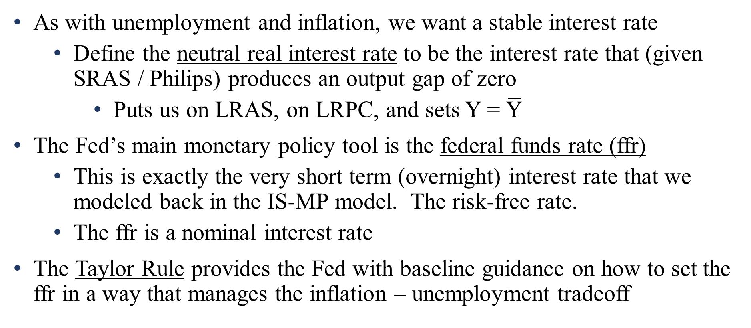
Picking the right interest rate
As with unemployment and inflation, we want a stable interest rate
Define the neutral real interest rate to be the interest rate that (given SRAS / Philips) produces an output gap of zero
Puts us on LRAS, on LRPC, and sets Y = $\overline{\text{Y}}$
The Fed’s main monetary policy tool is the federal funds rate (ffr)
This is exactly the very short term (overnight) interest rate that we modeled back in the IS-MP model. The risk-free rate.
The ffr is a nominal interest rate
The Taylor Rule provides the Fed with baseline guidance on how to set the ffr in a way that manages the inflation – unemployment tradeoff
Notes:
The neutral rate of interest is sometimes called the “natural” rate, as it coincides with the natural rate of unemployment as being the long run.
Remember from lecture 18 that real interest rate = risk-free rate + risk premium. We can alternately write, then, that real interest rate = ffr + risk premium

Slide 15
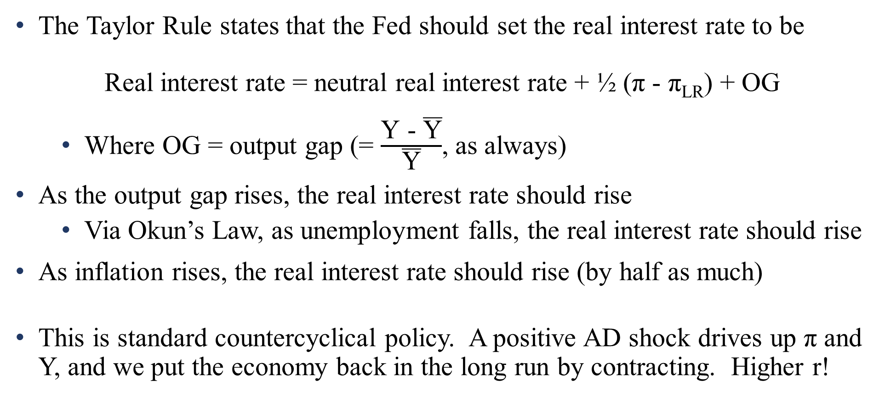
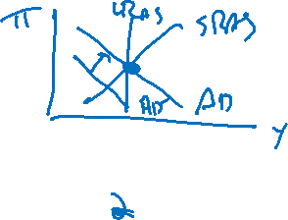
Picking the right interest rate
The Taylor Rule states that the Fed should set the real interest rate to be
Real interest rate = neutral real interest rate + ½ (π - π_{LR}) + OG
Where OG = output gap (= $\frac{\text{Y}\text{ − }\overline{\text{Y}}}{\overline{\text{Y}}}$, as always)
As the output gap rises, the real interest rate should rise
Via Okun’s Law, as unemployment falls, the real interest rate should rise
As inflation rises, the real interest rate should rise (by half as much)
This is standard countercyclical policy. A positive AD shock drives up π and Y, and we put the economy back in the long run by contracting. Higher r!
Notes:
Chapter 22 calls this the “Fed rule-of-thumb””. Anyone who has ever done macro in the last 20 years has heard of the Taylor Rule, so I’m going to call it that.
We’ve seen this Taylor rule already! This is the MP(π) curve. Remember that MP(π) tells us “how should interest rates rise as inflation rises”? That is very literally this.

Slide 16
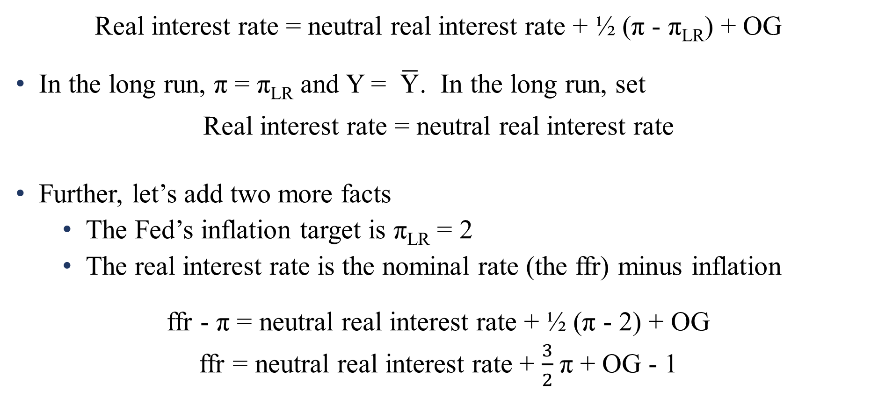

Picking the right interest rate
Real interest rate = neutral real interest rate + ½ (π - π_{LR}) + OG
In the long run, π = π_{LR} and Y = $\overline{\text{Y}}$. In the long run, set
Real interest rate = neutral real interest rate
Further, let’s add two more facts
The Fed’s inflation target is π_{LR} = 2
The real interest rate is the nominal rate (the ffr) minus inflation
ffr - π = neutral real interest rate + ½ (π - 2) + OG
ffr = neutral real interest rate + $\frac{3}{2}$π + OG - 1
Notes:
“real interest is nominal minus inflation” is the Fisher equation.
“Real interest = neutral real interest rate in the long run” is just the definition of the neutral rate.

Slide 17
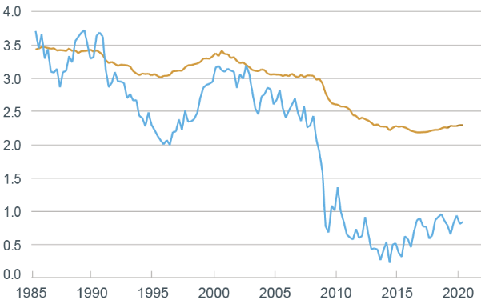
Picking the right interest rate
The neutral rate is important, but it (like the natural rate of unemployment) isn’t constant.
If there’s a negative AD shock, to put the economy back in the long run, the interest rate must fall.
We saw exactly that in 2008
Neutral rate was around r = 0.5 for the last decade
Was ~2.5% the decade prior
Output growth trend
Neutral real interest rate
Notes:
NY Fed estimation of the neutral rate or r*: https://www.newyorkfed.org/research/policy/rstar
When the neutral rate is 0.5, the Taylor Rule says
ffr = 0.5+ $\frac{3}{2}$π + OG – 1 → ffr = $\frac{3}{2}$π + OG – 0.5
When the neutral rate is 2.5, the Taylor Rule says
ffr = 2.5+ $\frac{3}{2}$π + OG – 1 → ffr = $\frac{3}{2}$π + OG +1.5

Slide 18
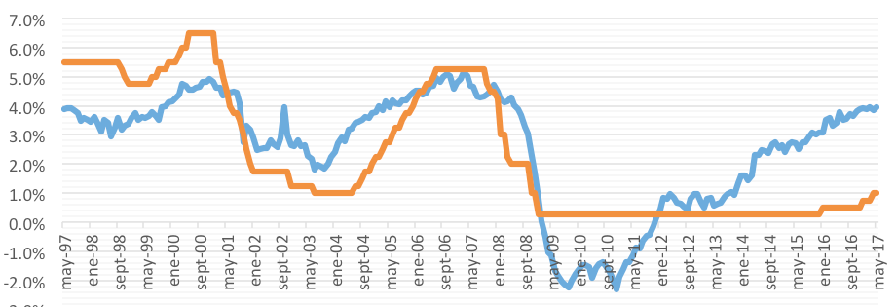
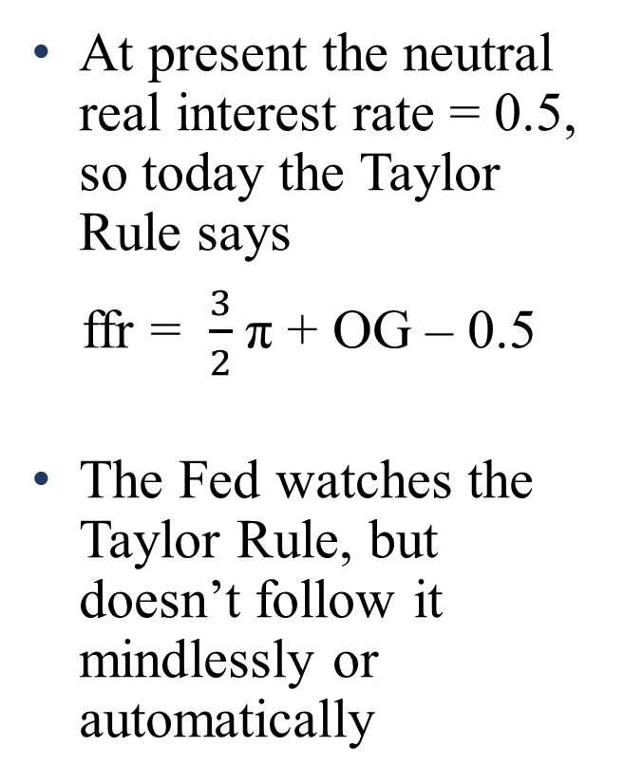
Picking the right interest rate
At present the neutral real interest rate = 0.5, so today the Taylor Rule says
ffr = $\frac{3}{2}$π + OG – 0.5
The Fed watches the Taylor Rule, but doesn’t follow it mindlessly or automatically
Taylor rule recommendation
Actual ffr
Notes:
The equation has a 0.5 because the neutral real r is +0.5 and -1/2*π_{LR} = -1. Add them together and you get -0.5
The Fed kept ffr low in the early 00s, relative to the Taylor Rule. Many people give this partial blame for the housing bubble (making borrowing too easy).
Interest rates were much higher than recommended in 2009-2010. Notice how they hit a floor at zero. We’ll come back to that. And even after the ffr lifts above zero in 2013, the Fed keeps ffr much lower. They are worried that the Taylor Rule is missing something. Remember (as we just saw in the last slide) that growth seems to have permanently slowed down in 2009. The Fed is worried that the Taylor Rule doesn’t reflect that reality – things are worse than the Taylor Rule believes, and so they are stimulating more than it recommends.

Slide 19
Tools of the Fed
The Federal Funds Rate is the most commonly discussed and applied tool of monetary policy. The “default” tool.
But the Fed has many arrows in its quiver. All of them make it easier or harder for banks to issue loans, which changes the level of investment I(r)
Many of the tools focus on the overnight market for interbank loans: very short very safe loans that match banks that are short on cash, with those that have more cash than they want on hand.
The federal funds rate sets the interest rate on the loans for banks that meet in the marketplace created by the Fed, the federal funds market
The Desk: The Fed can borrow excess reserves from banks overnight, via the Open Market Trading Desk

Slide 20
Tools of the Fed
Overnight market for interbank loans:
The Desk
The Desk buys and sells government bonds: shares of Federal debt
The Fed’s main tool used to be Open Market Operations: simply buy a bond, and give a bank money in exchange.
Nowadays, it is more common to use an overnight reverse repurchase agreement
The Fed sells a T-bill today. Commercial bank pays the Fed money.
The Fed promises to buy the T-bill back tomorrow, paying even more than the bank paid. That’s interest!
Notes:
Open Market Operations are where the Federal Open Market Committee gets its name
By doing an overnight reverse repurchase, the fed can influence the interest rate. The Fed is literally handing banks more money. When banks have more money, the interest rate falls (there is more saving / money in the economy, and higher supply means lower price), which encourages lending and investment

Slide 21
Tools of the Fed
Overnight market for interbank loans:
The discount rate
Sometimes a bank needs money overnight, but can’t find another commercial bank from which to borrow.
They can borrow money directly from the Fed, through the Discount Window, paying the interest rate of the discount rate
Historically seen as a bad sign for banks to use it: interpreted as being desperate & unable to find willing lenders elsewhere
Usually set at ffr + 1%
Notes:
Open Market Operations are where the Federal Open Market Committee gets its name

Slide 22
Tools of the Fed
Beyond the overnight market, the Fed has other monetary policy options
The reserve requirement
Remember that commercial banks engage in fractional reserve banking: hold onto some of their deposits, and they can lend out the rest.
The reserve requirement is the fraction of deposits a bank must hold.
Higher requirement → fewer loans → less investment → less output.
The US does NOT use this as a tool for monetary policy.
China very much does: slowly cut in half over last decade
Notes:
China reserve requirements: https://tradingeconomics.com/china/cash-reserve-ratio

Slide 23
Tools of the Fed
Other Fed tools
Bank of banks
In its role as the bank of banks, it can…
Issue longer-term loans to banks. Gives them more ability to loan themselves, stimulating investment
Or lend to non-banks: “Main Street Lending” of 2020
Pay interest on deposits.
Commercial banks can deposit their cash at the Fed, if they don’t want to hold it in house. (The Fed is VERY safe)
As the interest on those deposits rise, the Fed is transferring more money to banks, to be loaned etc.
Notes:
Fed details of Main Street Lending program: https://www.federalreserve.gov/monetarypolicy/mainstreetlending.htm
This program is designed to lend over $2 trillion to firms and state and local government. https://www.cnbc.com/2020/04/09/federal-reserve-unveils-details-of-its-much-anticipated-main-street-lending-program.html
This is not the same as the PPP loan (Paycheck Protection Program), which was intended to help firms cover payroll, and is administered by the US Small Business Administration

Slide 24
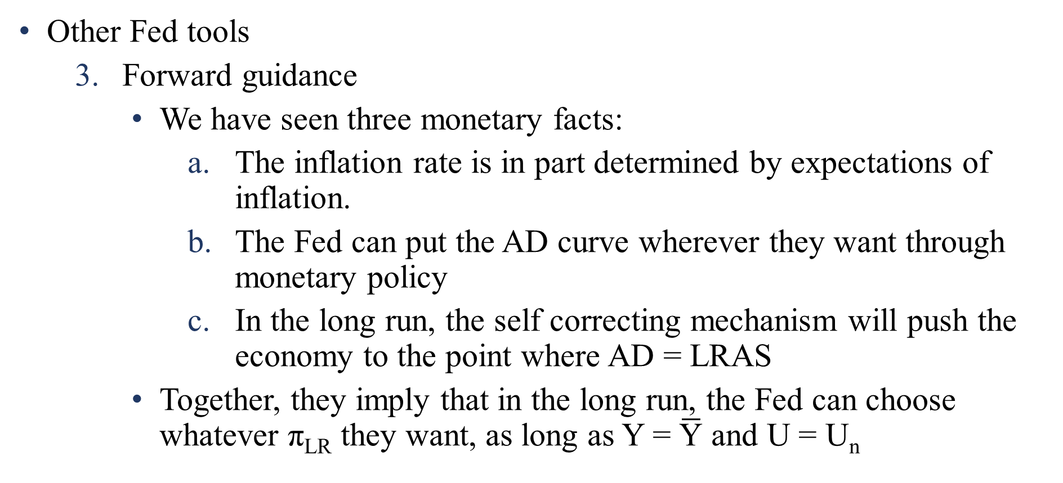
Tools of the Fed
Other Fed tools
Forward guidance
We have seen three monetary facts:
The inflation rate is in part determined by expectations of inflation.
The Fed can put the AD curve wherever they want through monetary policy
In the long run, the self correcting mechanism will push the economy to the point where AD = LRAS
Together, they imply that in the long run, the Fed can choose whatever π_{LR} they want, as long as Y = $\overline{\text{Y}}$ and U = U_{n}

Slide 25
Tools of the Fed
Other Fed tools
Forward guidance
Rational people know this! If the Fed says “we want inflation to be 2% in the long run”, and the Fed is credible, then rational people will set inflation expectations π_{e} = π_{LR} = 2%
“Credible” = “believable” = “always do what you say”
A credible Fed can simply announce that they want inflation to fall, and inflation will fall!
Of course, the Fed can’t just announce; needs to do exactly what it announces (or else belief in their policy is not rational)
Inflation changes with no real effects;

Slide 26

Tools of the Fed
SRAS when
π_{e} = 7%
π
LRAS
The Fed is very purposefully boring and predictable.
By being that way, they can change expectations easily, and it’s like always being in the long run!
The Fed often talks in “Fedspeak”, a technical forumulaic construction, to cultivate this (lack of) tradeoff!
SRAS when
π_{e} = 2%
7%
Jump to new LR with no Y or U tradeoff
New π_{LR}
= 2%
AD₁
Firms adjust
expectations by
exactly that
amount
Announce “r
will rise until
π falls 5 points”
AD₂
Y

Slide 27
Tools of the Fed
In theory (given a credible Fed and rational expectations) setting inflation expectations is very powerful tool.
In practice, because of the political realities of policy (expansion is popular, contraction is unpopular), it is easy to build in expectations of inflation, and hard to get rid of them
Fighting inflation can mean a long period of painful contraction
The “Volker recession” of 1982-83 was created to bring US inflation down. It generated costs – foregone output - equivalent to 18% of one year’s GDP
That’s one reason we have a Fed! They are relatively insulated from short-term political pressures

Slide 28
Next:
Issues in countercyclical policy

